Slide 1


11/14/2023
Tableau: What it is and What it Do
Presented By:
Presented To:
christian mack
NSS Data analytics

Slide 2
Agenda
1 | What is Tableau?
2 | What can it do?
3 | hands-on demo
4 | QRGs for tableau mastery

Slide 3
Tableau Definitions
•A worksheet contains a single view along with shelves, cards, legends, and the Data and Analytics panes in its side bar. For details on the worksheet workspace, see The Tableau Workspace.
•A dashboard is a collection of views from multiple worksheets. The Dashboard and Layout panes are available in its side bar. For more details about creating dashboards, see Dashboards.
•A story contains a sequence of worksheets or dashboards that work together to convey information. The Story and Layout panes are available in its side bar. For more details about creating stories, see Stories.

Slide 4
Business Case #1
The product management team at your company has come to you with a request for a product-focused dashboard. Here is the request:
We would like to be able to see total sales by state with the ability to drill down into cities if possible. Sales by month would be good. Charts to show highest and lowest selling products. KPIs should include total sales, profit, and profit margins.

Slide 5
Business Case #1 Translated
Create a map with the highest sales per state
Create a chart that shows the sales per month
Create a chart showing the top 5 highest and lowest selling products
Create a visual card showing all sales, profit, and profit margin
Allow the end-user to filter by year and product.

Slide 6
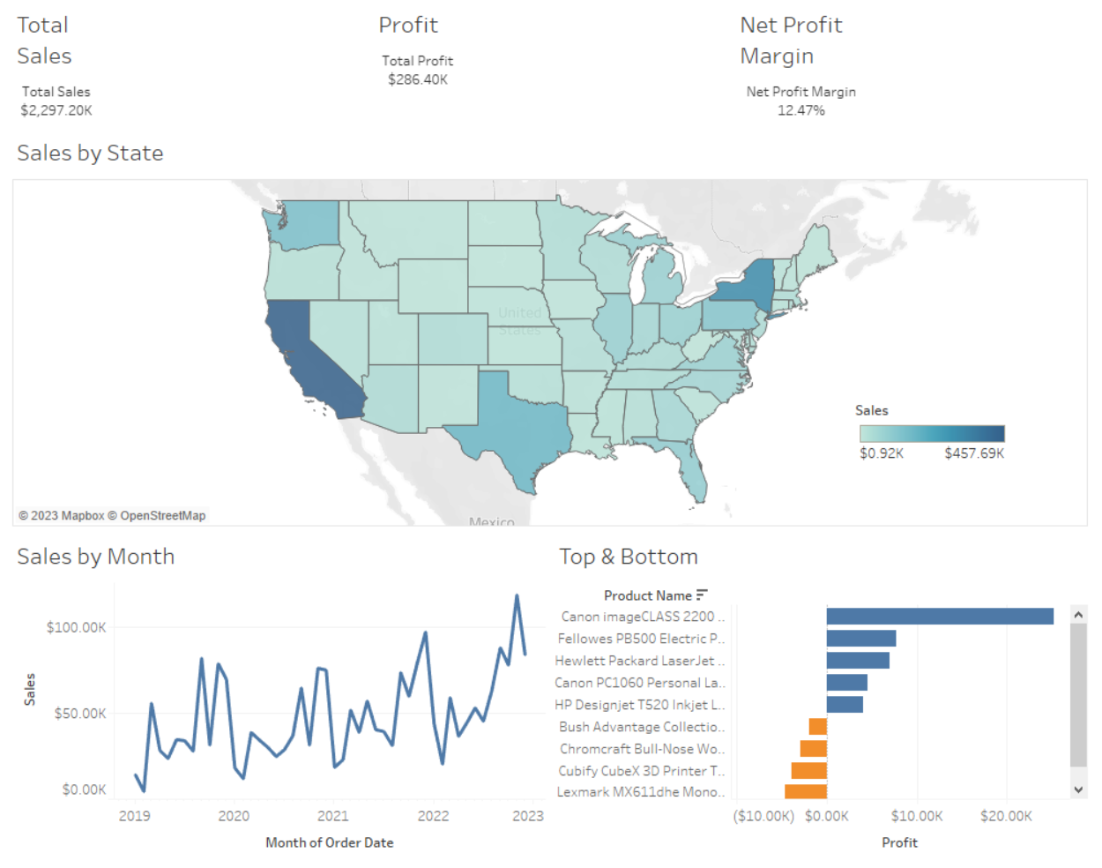

Slide 7
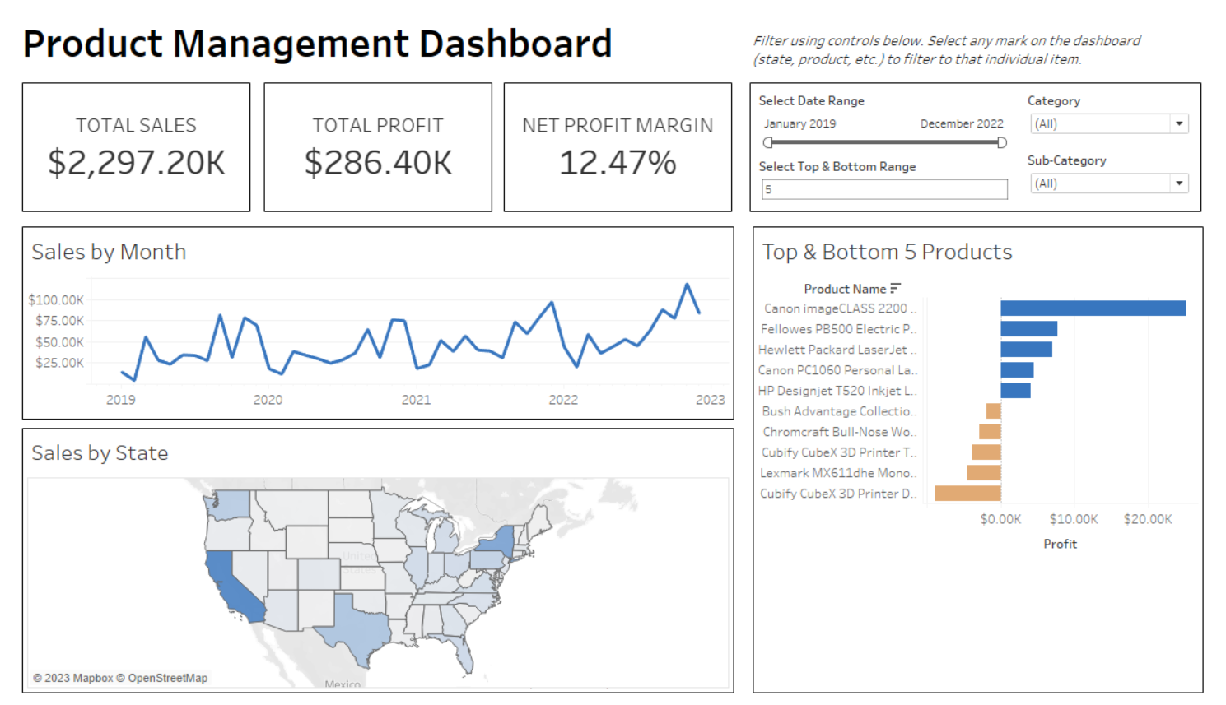

Slide 8
What Improved
Borders & spacing
Clearly defined color palette
Hierarchized text and fonts
De-cluttered by removing any useless elements
Added filters
Added title
Added instructions

Slide 9
Dashboarding Reminders
Remember your audience
Provide as much value as possible
Is it a VP? A business user? other analysts?
cater your visuals to the user
Ask the right questions before you start
Look for opportunities to provide important context
make the user interface as seamless as possible
always look to improve
Notes:
Develop good habits now - get sleep, go to the gym, encourage brain activity

Slide 10
Business Case #2
A project for the sales team has come across your desk. The goal of the project is to figure out which customers and regions are the most and least profitable. Additionally, they would like to see what products the customers/regions are consuming so they know which products to push and which to pull back.

Slide 11
Business Case #2 Translated
Create a chart that compares profit and sales by customer and region
Create a chart that shows profitable product categories and products
Provide the end-user with the functionality to switch between customer and region

Slide 12
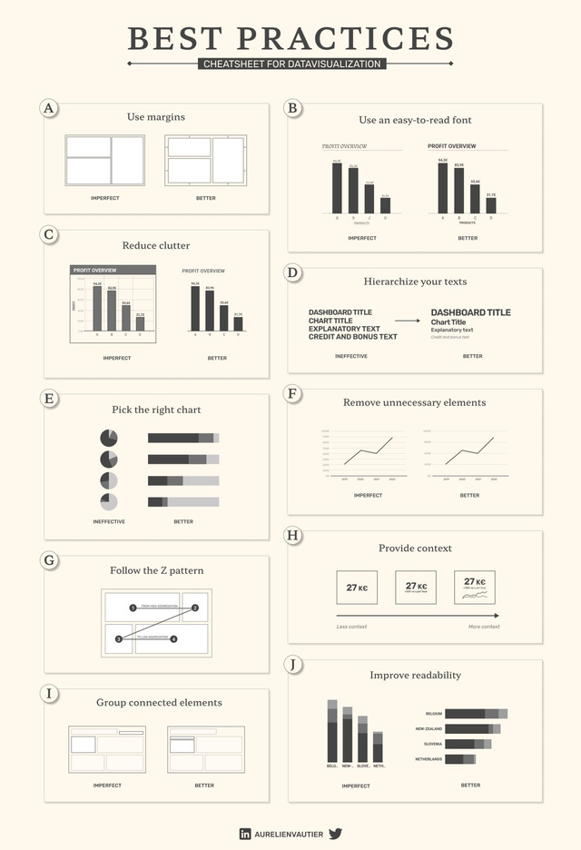
Dashboarding Quick Reference Guide
Tableau Tips & Tricks
Tableau Chart Builder by Jeff Plattner
Real World Fake Data project - search #RWFD on Tableau Public for examples
The Flerlage Twins blog
UI/UX design
How to Make UI Color Palettes
Free Color Palettes
60/30/10 Rules
Figma

Slide 13
Contact
Email: Christian.mack@live.com
Phone: 615-478-9513
Find me on Linkedin!

